Slide 1
GloCal Career Development
Luis Menacho, MD, MPH
luis.menacho@upch.pe

Slide 2
Background
Undergraduate: MD, UPCH, Peru.
2006: Peruvian NIH; assistant of the
Management
First approach w/ Public Health.
> Health administration
Different areas, diseases, working groups, government (MOH), etc.
NIH Perú

Slide 3
Background
2008-2010: Fogarty Training Grant, International AIDS Research Training Program
MPH, University of Washington in Seattle.
Medical epidemiologist
UW: skills to become a researcher
Junior Faculty --> at UPCH (Cayetano Heredia University): HIV research, improving the HIV continuum of care; ICT for health promotion for this and other infectious diseases.

Slide 4
Mentoring
Diversity of mentors
Different kind of support (areas, skills, etc.)
Patty (promote a career in public health)
Joe (first US mentor and throughout)
Magaly (common interests)
Larissa (peer)
Elsa (new working group)
Eduardo (institutional support)
Ann (current main K43 mentor, the best!)

Slide 5
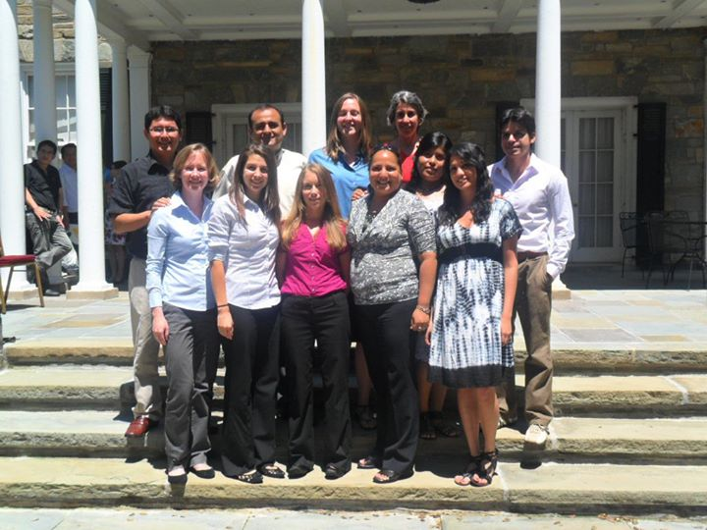
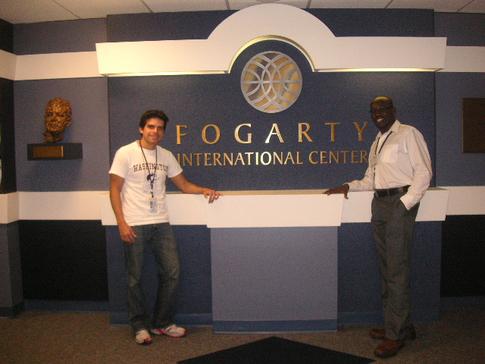
Fogarty
Research and training support
Move forward in my career
MPH –> Fellowship –> Other research…
K43 award
Networking

Slide 6
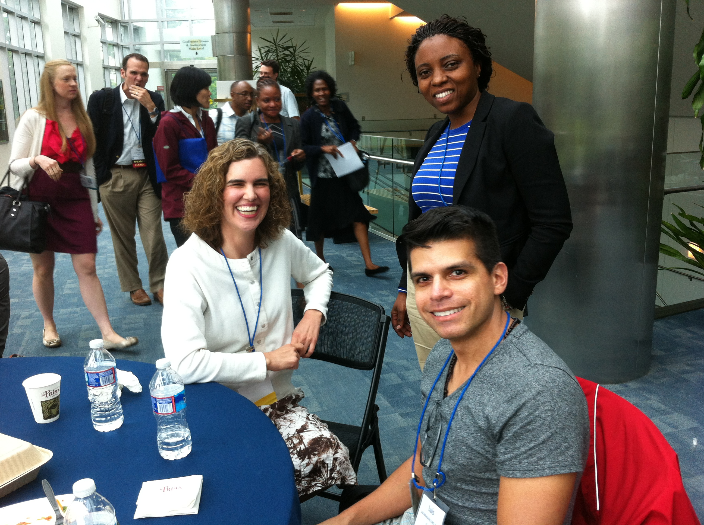
GloCal
2013
Move forward in my research area
Consolidate my experience
(opportunities for new jobs)
Meet my friend Kimberly Bale ☺

Slide 7
Continuous learning
Formal training
Other: online courses, webinars, conferences, etc.
Work at different institutions: government, community centers, NGO, academia
Teaching
Becoming a mentor

Slide 8
Collaboration in international setting
University of Washington (based in Peru)
University of British Columbia (WelTel in LATAM)
NGO Via Libre –> International HIV/AIDS Alliance
South Africa, Latin America (CBOs)

Slide 9
Grant funding for research
Fogarty & others (GCC)
K43 award (improving retention in care using ICT)
Three times (one old idea / the new idea & resubmission)
Some tips:
You really need to focus, at least the first time (I quit my job at the NGO)
Optimize the support of your team
Be strategic to choose your team and training plan
Read well what reviewers said (at least the first time)

Slide 10
Publication and dissemination
Hard!
Avoid trying to change the world with a single manuscript
Focus (main results)…and other sections
Scientific journals are not the only means
Social media, conferences, presentations, courses, etc. Share your results!

Slide 11
Balancing professional and personal life

