Slide 1
SUCCESS IN GLOBAL HEALTH CAREERS ( OR IN OTHER WORDS CLIMBING THE MOUNTAIN)
Elizabeth Anne Bukusi,
MBChB, M.Med (ObGyn), MPH, PhD , PGD(Research Ethics). MBE (Research Ethics) .
Chief Research Officer,
KEMRI
GLOCAL 2018 JUNE

Slide 2
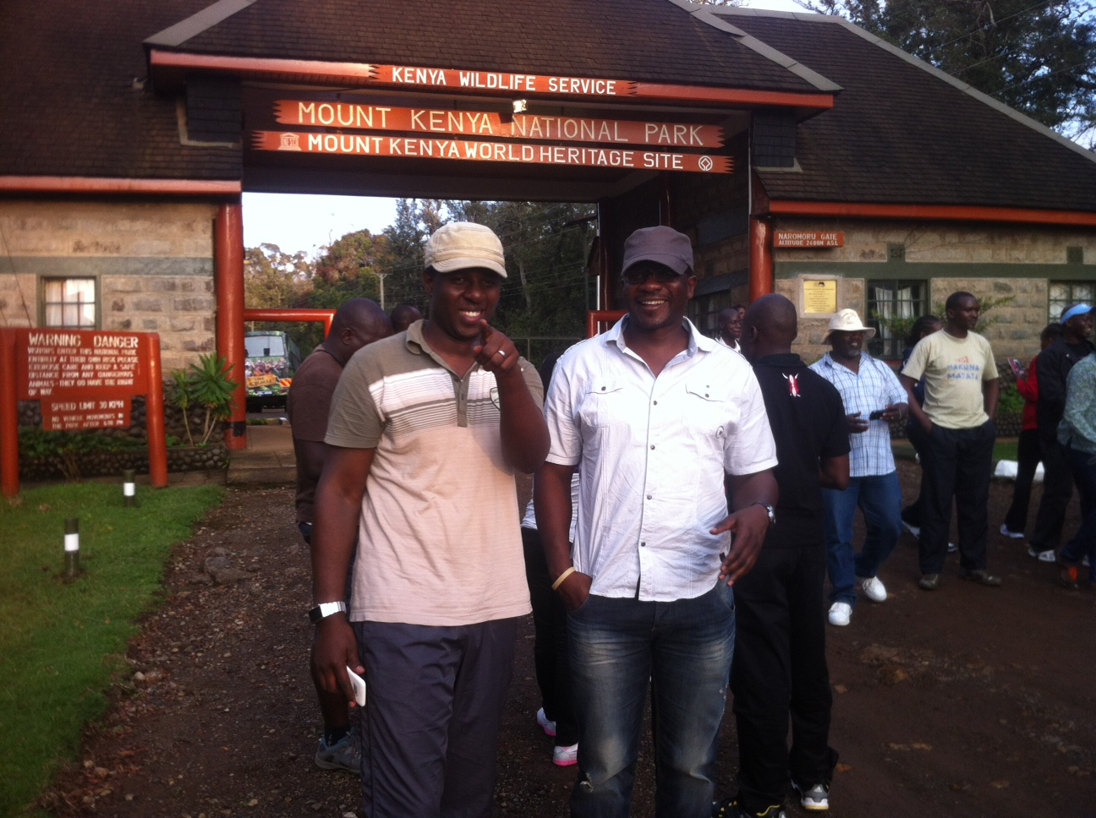

Slide 3
OUTLINE
Climbing the mountain
Curiosity and willingness to learn
Collaboration
Networking
Work life balance
Persistence
Open doors and closed windows
Dissemination
Integrity

Slide 4
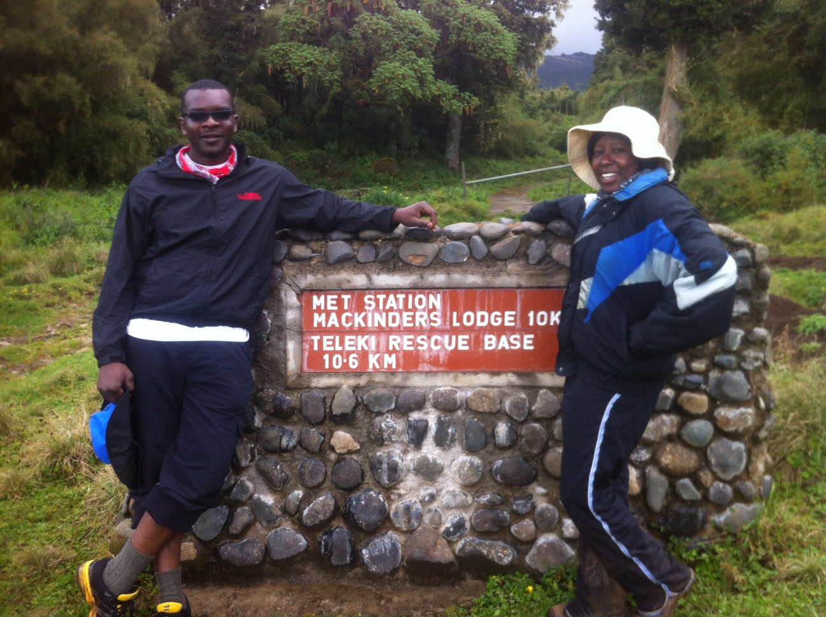

Slide 5
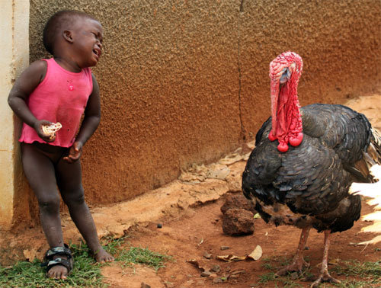
Curiosity and willingness to learn

Slide 6
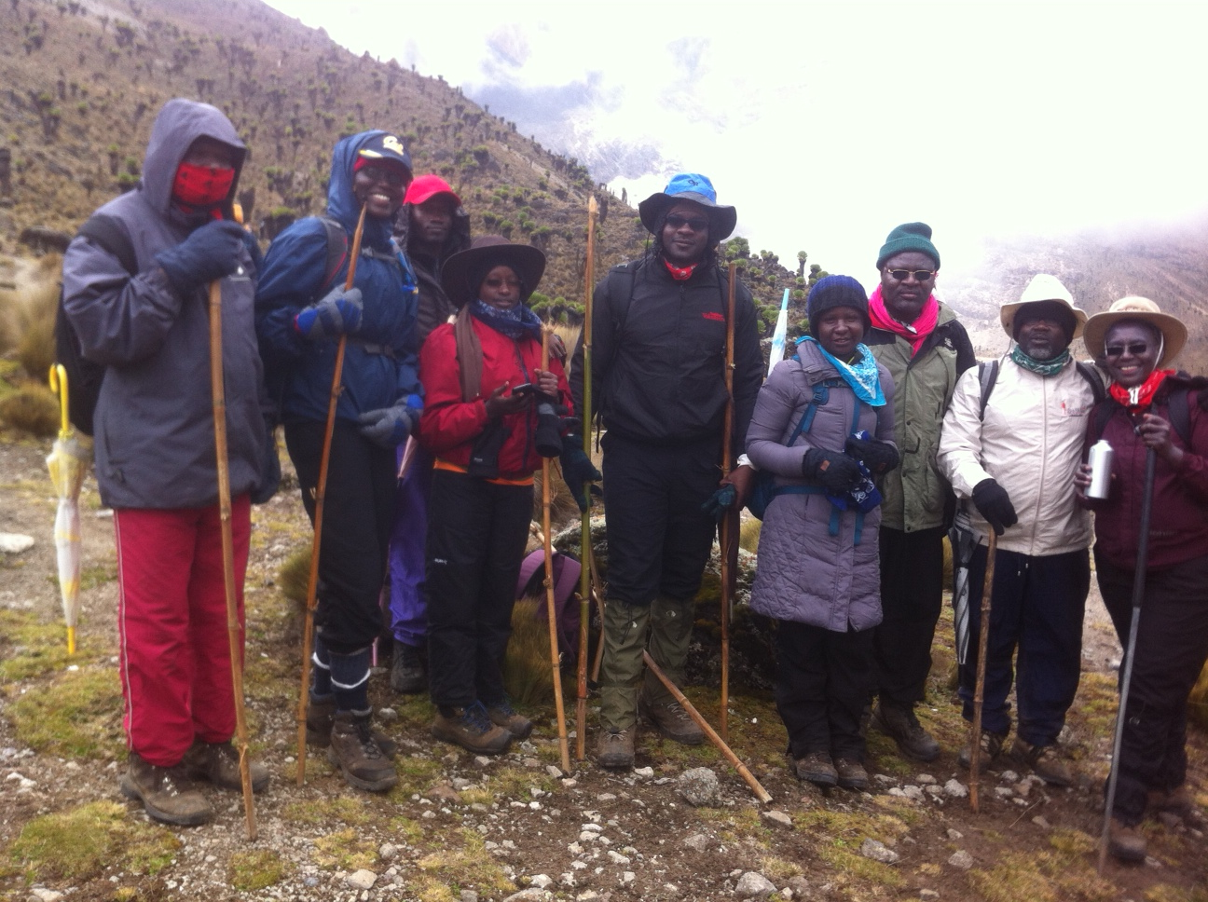

Slide 7
Collaboration

Slide 8
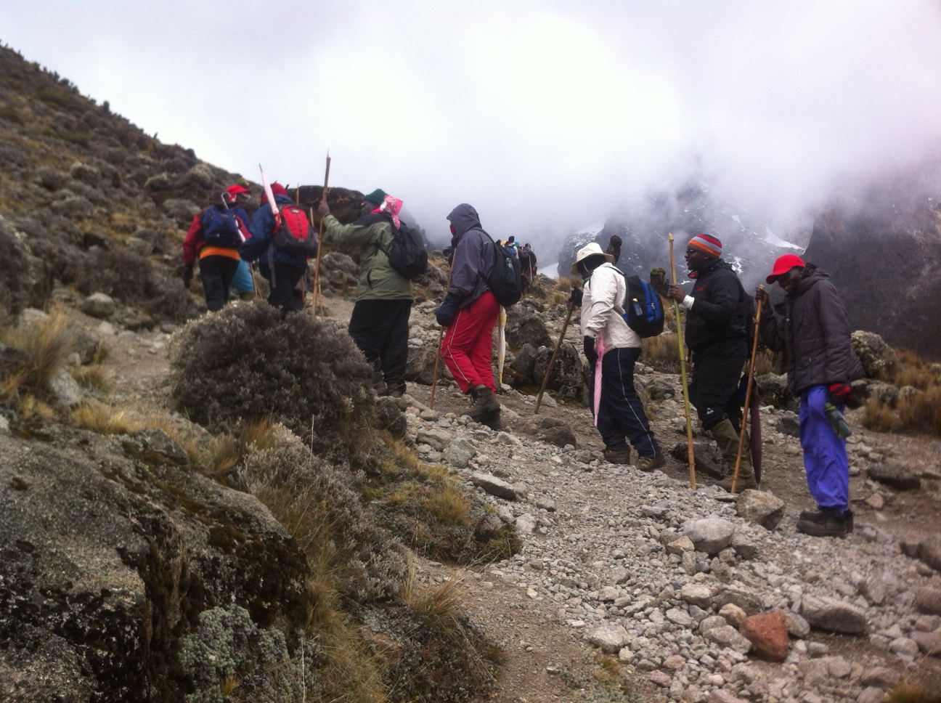

Slide 9
Networking

Slide 10
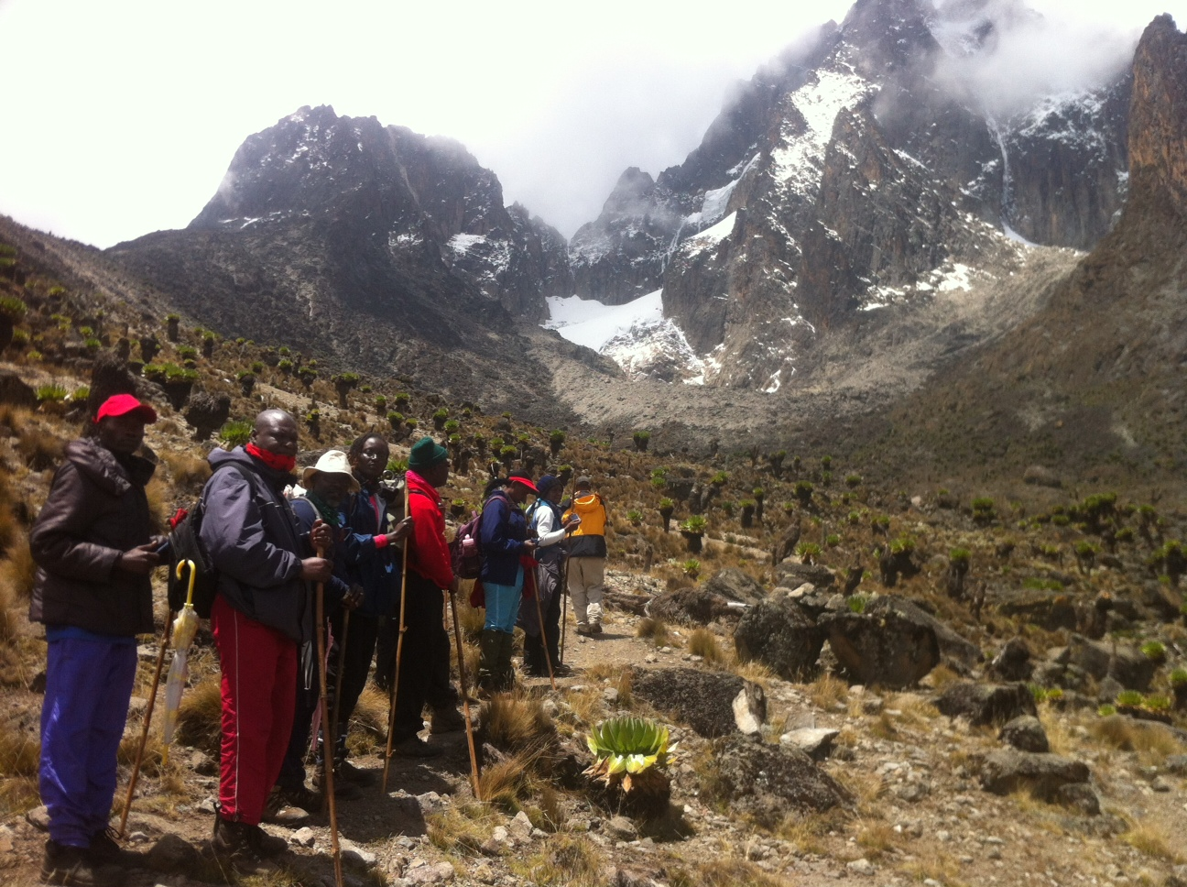

Slide 11
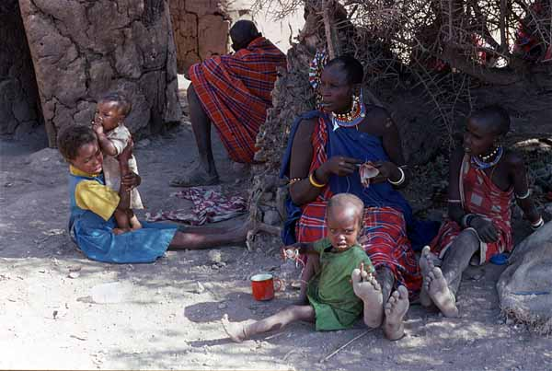
Work life balance

Slide 12
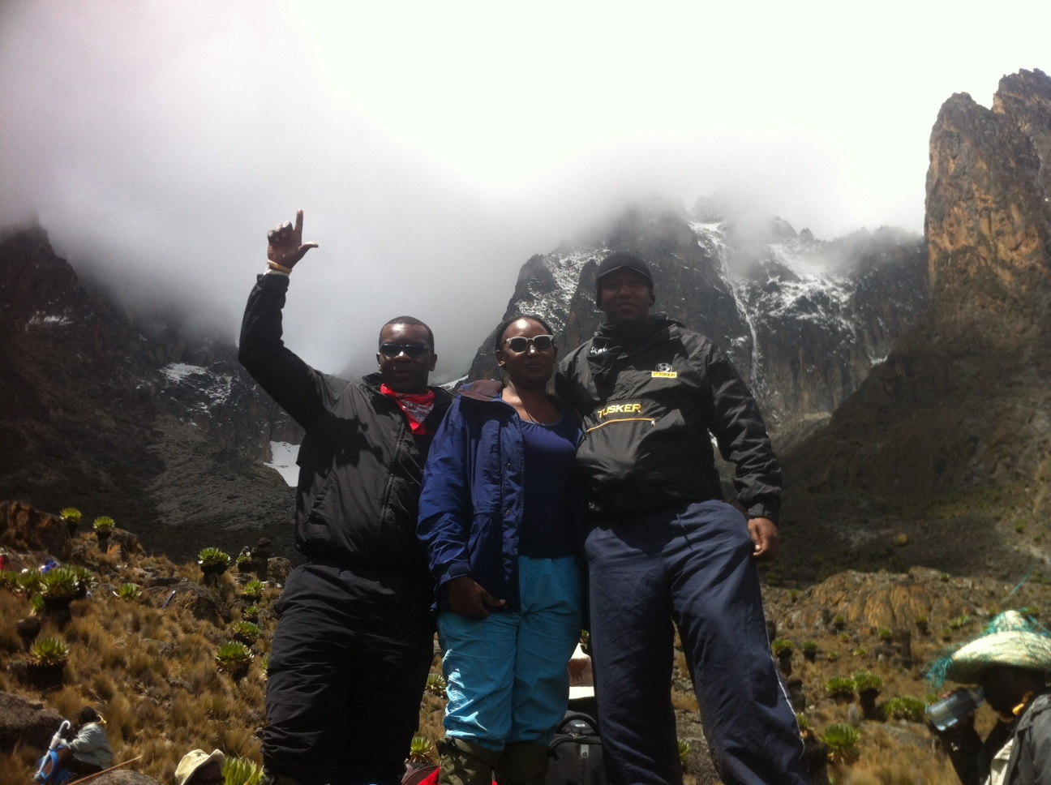

Slide 13
Persistence

Slide 14
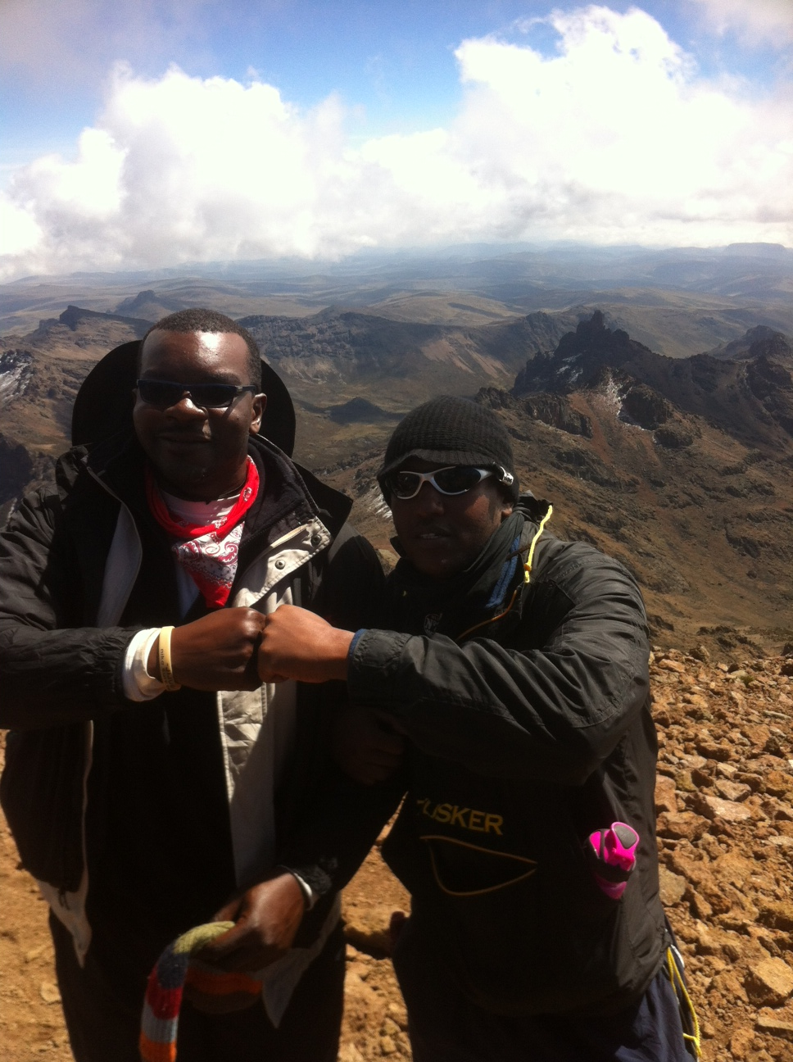

Slide 15
Open doors and closed windows

Slide 16
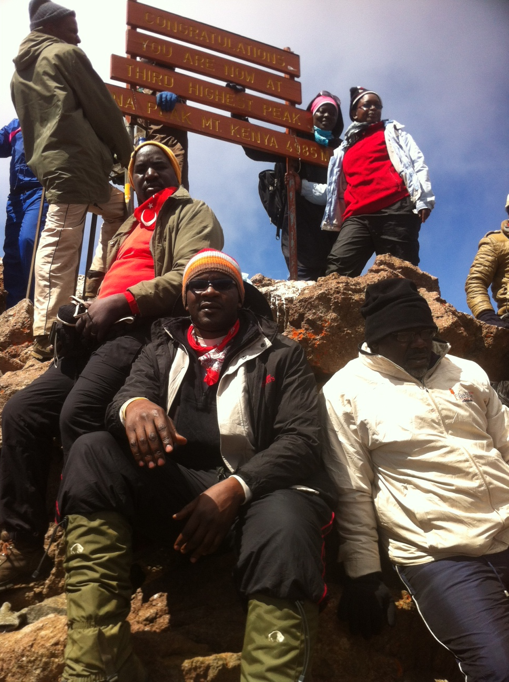

Slide 17
Dissemination

Slide 18
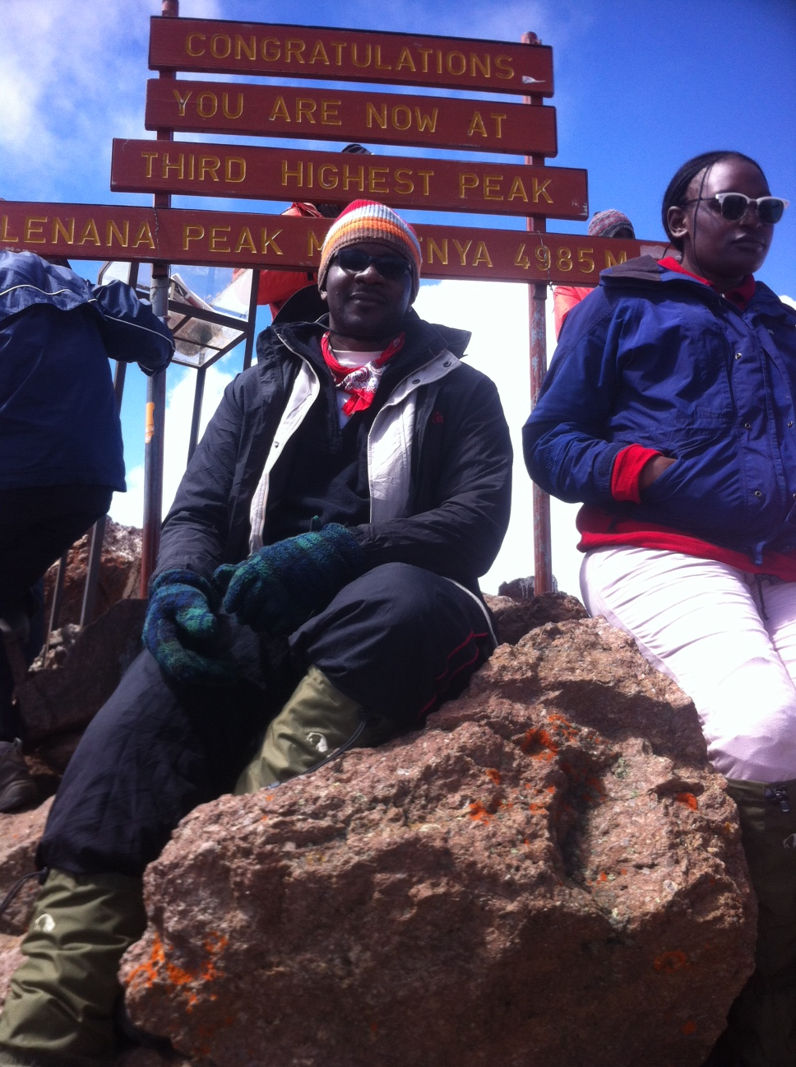

Slide 19
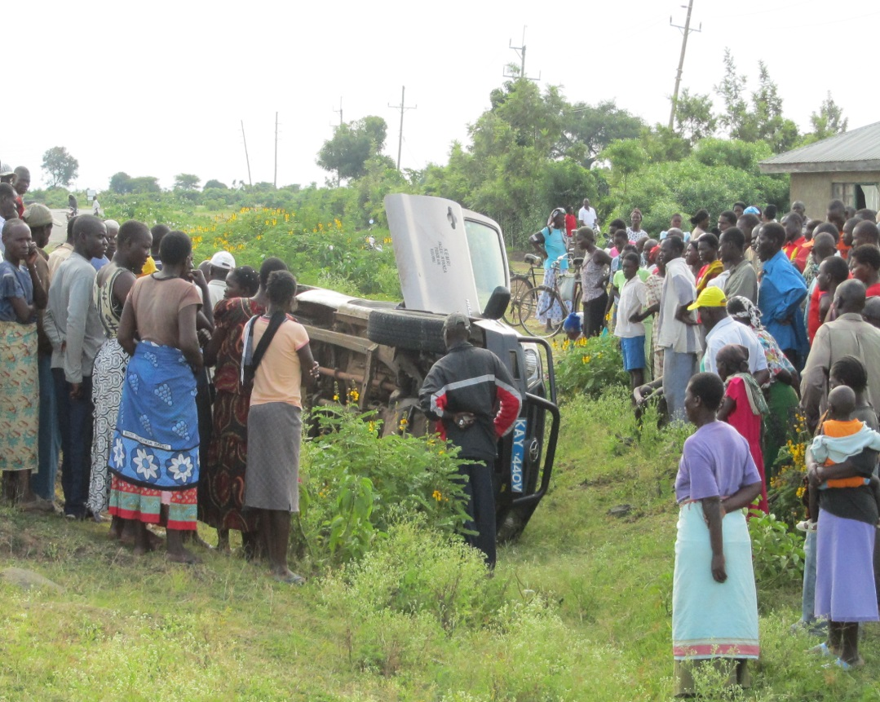
Integrity

Slide 20
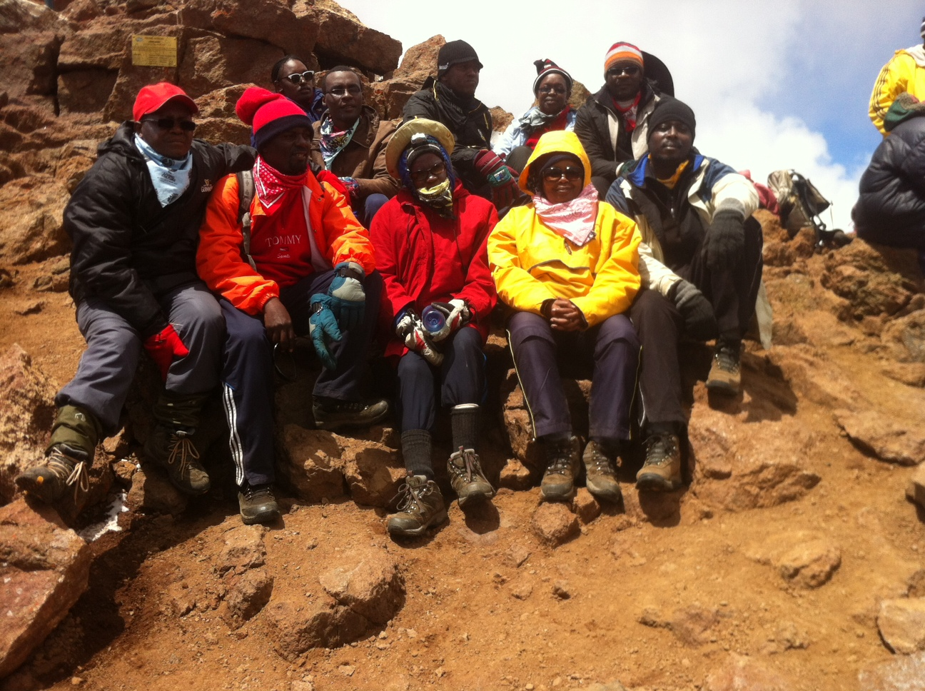

Slide 21
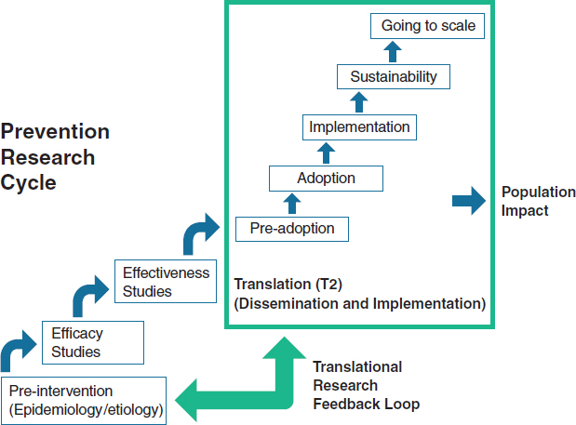

Slide 22
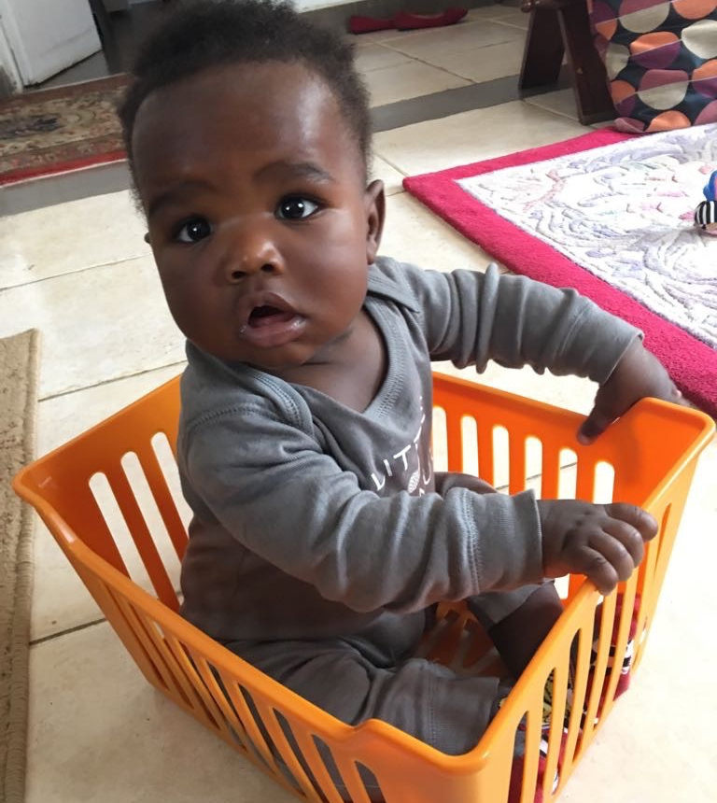
In Summary
It will not be easy, but it will be worth it

Slide 23
